Slide 1

WEB DEVELOPMENT INTERNSHIP
Internship Presentation
Student Name
ANAND RAJ
Enrollment No.
25SCS1003005435
Program & Semester
B.Tech CSE | Semester: 3rd
Batch
2025 – 2029
Organization
Prodigy InfoTech
Internship Period
15 August 2026 – 15 September 2026
School of Computer Science and Engineering
IILM University, Greater Noida, U.P.

Slide 2
Internship Overview
A practical full-stack web development internship focused on building and understanding web application workflows.
15 Aug 2026
Task-based work
Testing
15 Sep 2026
Internship begins
Frontend + backend development
Browser, API and database validation
Internship completion
Task track
Internship focus
• 01 Secure User Authentication
• 02 Employee Management System
• 03 Local Store E-commerce Platform
• 04 Real-Time Chat Application
• 05 Social Media Platform
• User-facing web interfaces
• Server-side APIs and application logic
• Authentication, validation and secure handling
• MongoDB-backed data storage
• Testing, debugging and documentation
Anand Raj | Web Development Internship | Prodigy InfoTech
2

Slide 3
Objectives & Scope
Objectives
Scope
• Gain practical experience in full-stack web development.
• Strengthen HTML, CSS and JavaScript skills.
• Understand Node.js and Express.js server-side development.
• Implement secure registration, login and protected routes.
• Use password hashing and token-based authentication.
• Connect applications with MongoDB for persistent data.
• Improve debugging, testing and problem-solving skills.
• Authentication and protected resource access
• Employee record CRUD workflows
• E-commerce catalogue and shopping flow
• Real-time communication concepts
• Social media interaction concepts
• Responsive and user-friendly interfaces
• Documentation using screenshots and structured reporting
Anand Raj | Web Development Internship | Prodigy InfoTech
3

Slide 4
Technologies & Tools
HTML5
CSS3
JavaScript
Page structure, forms and content
Layout, styling and responsive presentation
Client-side interaction and logic
Node.js
Express.js
MongoDB / Mongoose
Server-side JavaScript runtime
Backend server and API routes
Persistent data and database operations
bcrypt
JWT
VS Code
Password hashing
Token-based authentication
Development environment
Git / GitHub
Version control and submission
Core implementation documented in the report: Secure User Authentication with Node.js, Express.js, MongoDB, bcrypt and JWT.
Anand Raj | Web Development Internship | Prodigy InfoTech
4

Slide 5
System Architecture – Secure Authentication
Client–server flow used by the implemented authentication application
Browser / UI
Node.js + Express
Security Layer
HTML • CSS • JavaScript
API routes • validation • logic
bcrypt • JWT • protected routes
MongoDB
User records • persistence
Requests → validation → database/security checks → authenticated response
Anand Raj | Web Development Internship | Prodigy InfoTech
5

Slide 6
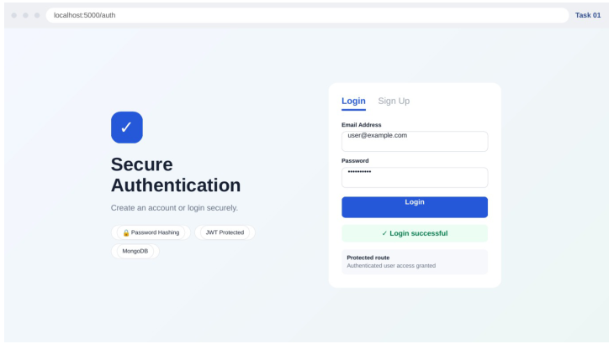
Task 1 – Secure User Authentication
Task objective
Implement secure sign-up, login and protected-route access.
Key features demonstrated
• Login and registration interface
• Password hashing
• JWT-based authentication
• Protected route access
• MongoDB-backed user records
Working output documented in the report.
Anand Raj | Web Development Internship | Prodigy InfoTech
6

Slide 7
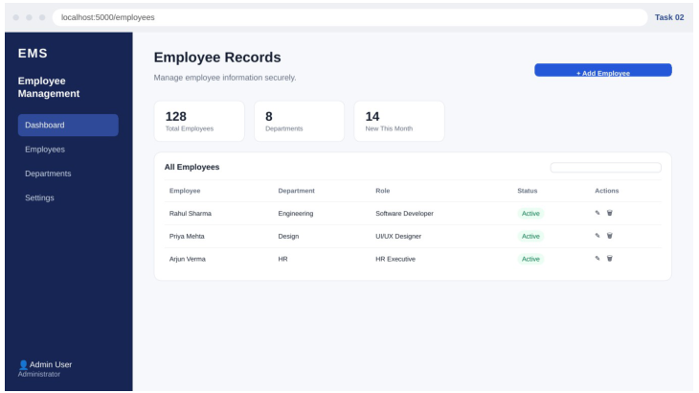
Task 2 – Employee Management System
Task objective
Enable administrators to perform CRUD operations on employee records with validation and authentication.
Key features demonstrated
• Employee dashboard
• Add / read / update / delete controls
• Department and role information
• Searchable employee records
• Authenticated administrative interface
Anand Raj | Web Development Internship | Prodigy InfoTech
7

Slide 8
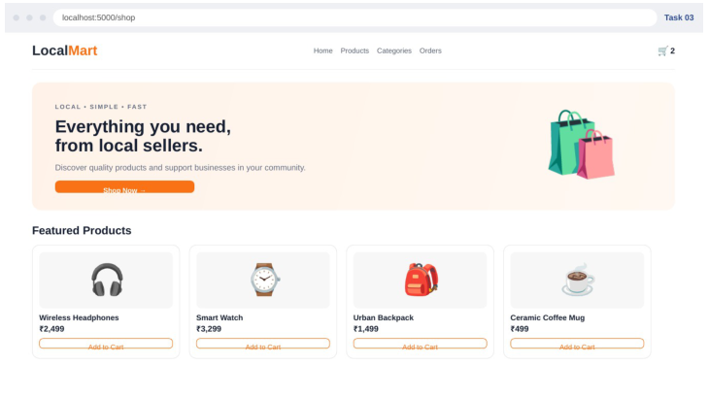
Task 3 – Local Store E-commerce Platform
Task objective
Enable customers to browse products and purchase through a practical shopping interface.
Key features demonstrated
• Product catalogue
• Product cards and prices
• Shopping cart indicator
• Category/navigation interface
• Add-to-cart interaction
Anand Raj | Web Development Internship | Prodigy InfoTech
8

Slide 9
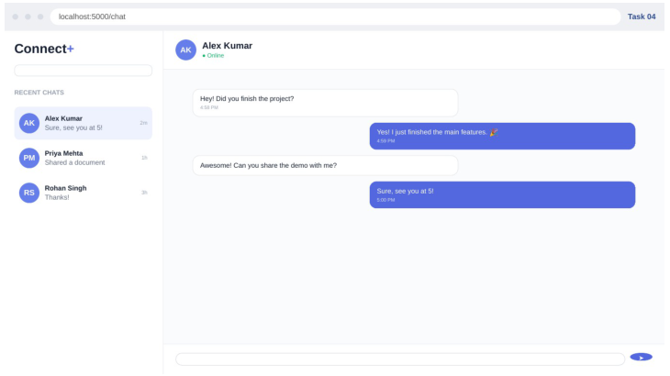
Task 4 – Real-Time Chat Application
Task objective
Use WebSocket technology to enable instant messaging between users.
Key features demonstrated
• Conversation list
• Online status
• Message history
• Sender/receiver message styling
• Message composer
Anand Raj | Web Development Internship | Prodigy InfoTech
9

Slide 10
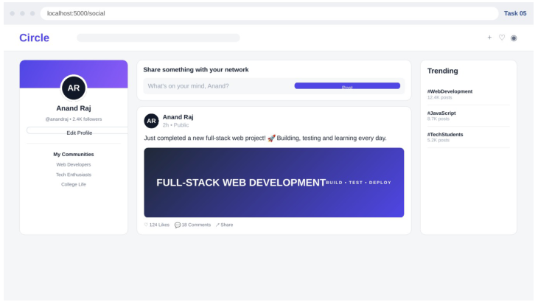
Task 5 – Social Media Platform
Task objective
Allow users to create profiles, share posts and interact with other users.
Key features demonstrated
• User profile
• Post composer
• Feed-style post
• Likes / comments / share controls
• Trending topics
Anand Raj | Web Development Internship | Prodigy InfoTech
10

Slide 11
Results & Learning Outcomes
The internship connected requirements, implementation, testing and documentation across a range of web application concepts.
Key outcomes
Development workflow
• Improved understanding of full-stack web application structure.
• Practical experience with HTML, CSS and JavaScript.
• Better understanding of Node.js and Express.js.
• Understanding of secure password storage and token-based authentication.
• Practical experience connecting an application to MongoDB.
• Improved debugging and browser-based testing skills.
• Better ability to translate task requirements into interfaces.
• Experience documenting development work with screenshots and reports.
1
Requirement
2
UI / Structure
3
Backend / Data
4
Testing
5
Documentation
Anand Raj | Web Development Internship | Prodigy InfoTech
11

Slide 12
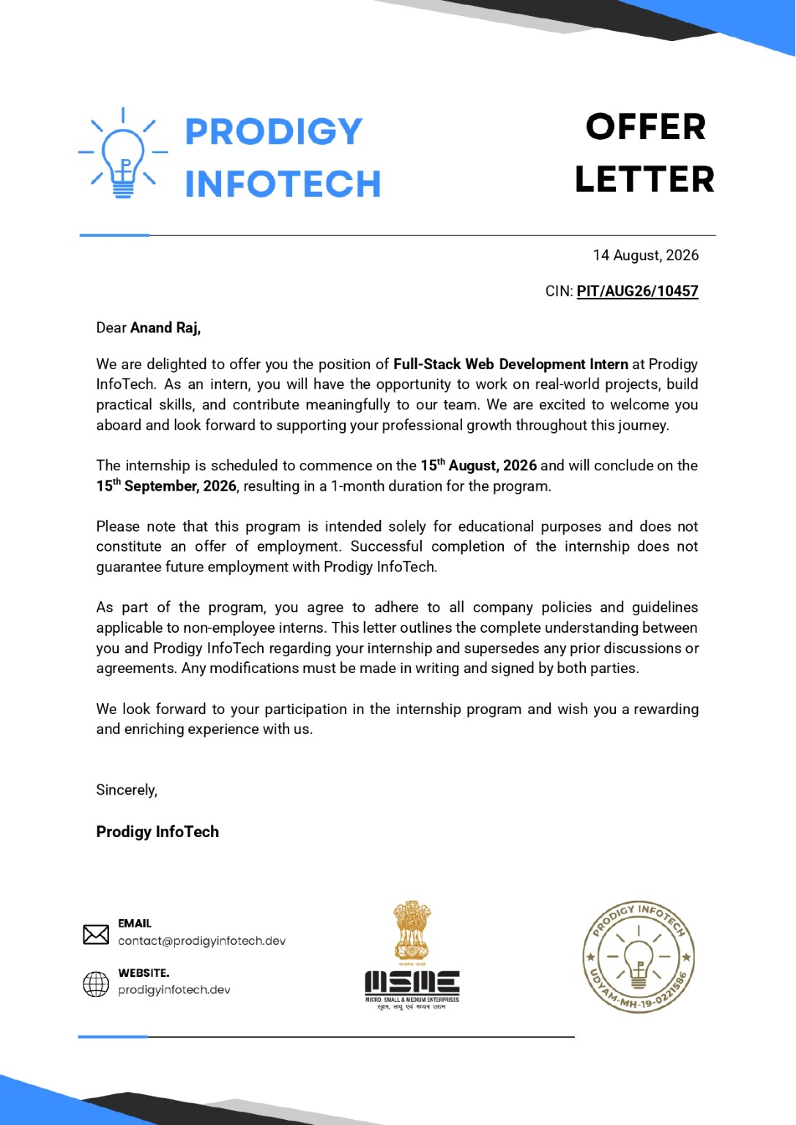
Supporting Document – Offer Letter
Anand Raj | Web Development Internship | Prodigy InfoTech
12

Slide 13
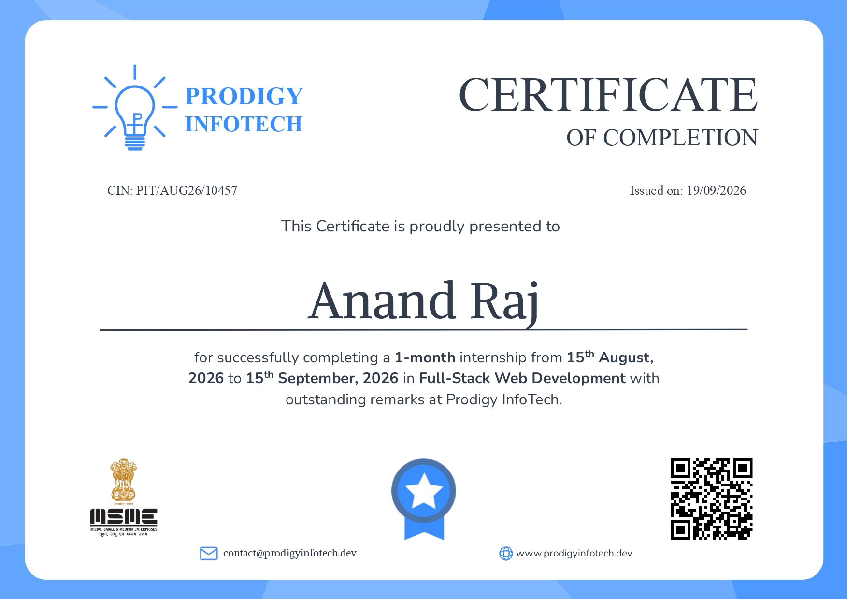
Supporting Document – Internship Completion Certificate
Anand Raj | Web Development Internship | Prodigy InfoTech
13

Slide 14
Conclusion
Thank You
Web Development Internship
Prodigy InfoTech
The internship strengthened practical skills in web development, authentication,
backend APIs, database connectivity, testing and technical documentation.
ANAND RAJ | B.Tech CSE | IILM University, Greater Noida
Anand Raj | Web Development Internship | Prodigy InfoTech
14

